Slide 1
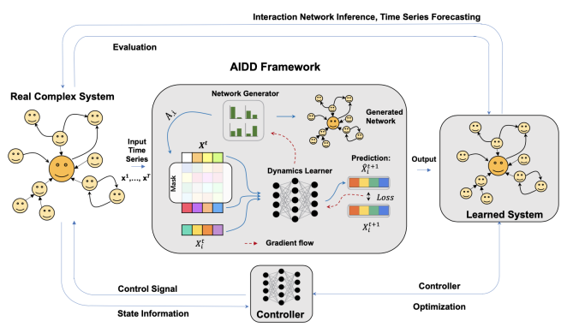

Automated Modelling for
Complex Systems
张江
北京师范大学系统科学学院教授
集智俱乐部、集智学园创始人
集智研究中心理事长
更多“人工智能 & 复杂系统”的知识，请关注官网：campus.swarma.org
Notes:
封面

Slide 2

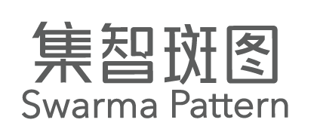
Outline
Complex Systems and Modelling Methods
Dynamics Learning
Network Reconstruction
Multi-scale Modelling
Simulation, optimization, and control
更多“人工智能 & 复杂系统”的知识，请关注官网：campus.swarma.org

Slide 3
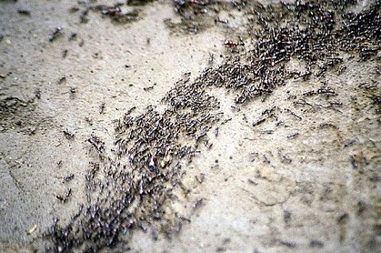
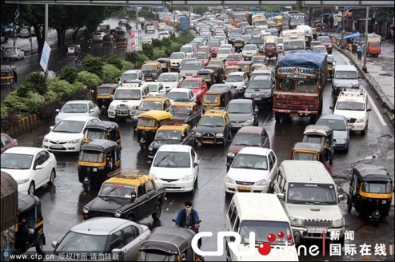

What are Complex Systems?
更多“人工智能 & 复杂系统”的知识，请关注官网：campus.swarma.org

Slide 4
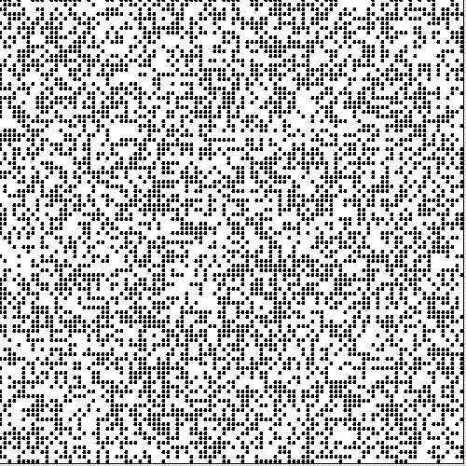
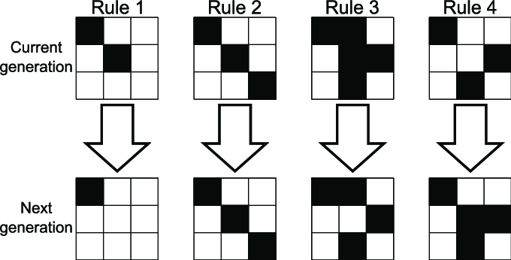
Game of Life
Conway’s GAME of LIFE
Each cell has 8 neighbors
Change color according to neighbors
Studying complexity
更多“人工智能 & 复杂系统”的知识，请关注官网：campus.swarma.org

Slide 5
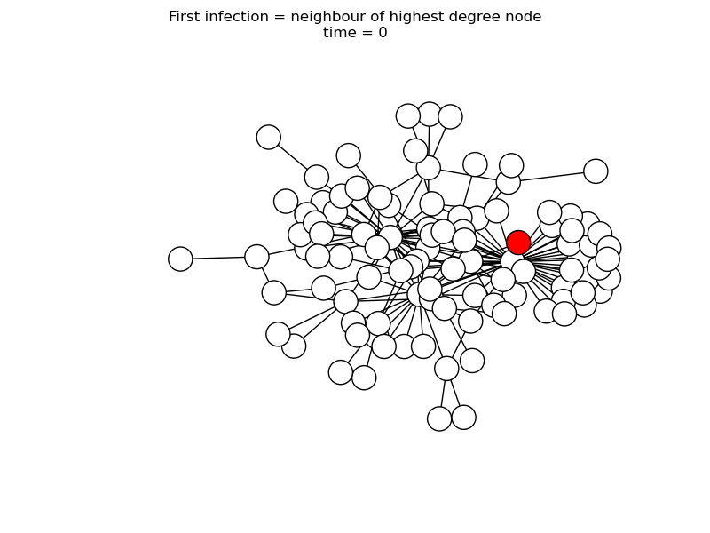
SIR on Network
SIR model
S node (white) can be infected by the infectious node (red)
Infectious node can turn to recovered (grey)
更多“人工智能 & 复杂系统”的知识，请关注官网：campus.swarma.org

Slide 6
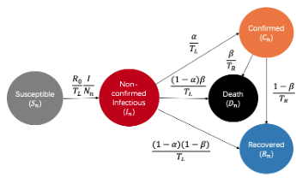
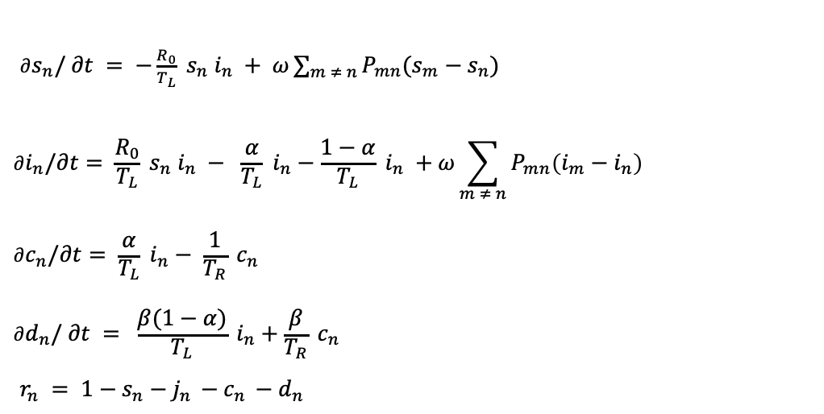
Epidemic
$∂s_{n}/ ∂t = −\frac{R_{0}}{T_{L}} s_{n} i_{n} + ω\sum_{m ≠ n}{P_{mn}(s_{m}−s_{n})}$
$$∂i_{n}/∂t= \frac{R_{0}}{T_{L}} s_{n} i_{n} − \frac{α}{T_{L}} i_{n}−\frac{1−α}{T_{L}} i_{n} +ω\sum_{m ≠ n}{P_{mn}\left(i_{m}−i_{n}\right)}$$
$$∂c_{n}/∂t= \frac{α}{T_{L}} i_{n}− \frac{1}{T_{R}} c_{n}$$
$$∂d_{n}/ ∂t = \frac{β(1−α)}{T_{L}} i_{n}+\frac{β}{T_{R}} c_{n}$$
$r_{n} = 1−s_{n}−j_{n }−c_{n }−d_{n }$
Jiang Zhang,et al. Investigating time, strength, and duration of measures in controlling the spread of COVID-19 using a networked meta-population model; Nonlinear Dynamics 101(10223) (2020)

Slide 7
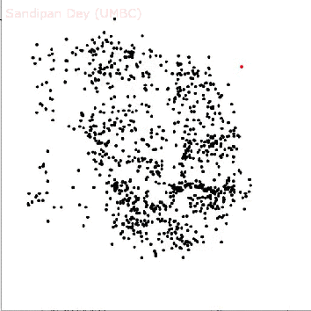
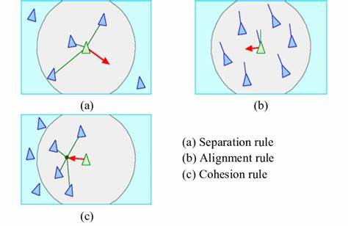
Boid Model
Boid model
Each boid follows 3 rules
Cohesion
Alignment
Separation
更多“人工智能 & 复杂系统”的知识，请关注官网：campus.swarma.org

Slide 8
Boids Model
Benefits:
Simple & concise
More insightful
More theoretical analysis
Cheap computation
Drawbacks:
Too Simple to explain complex phenomenon
Difficult to incorporate real data
Poor prediction accuracy
Rely on Human Heuristics
Case by Case
更多“人工智能 & 复杂系统”的知识，请关注官网：campus.swarma.org

Slide 9
Automated Modelling of Complex Systems
Complex System
Behavior (observations)
AI systems
Models
Prediction, Simulation, Optimization, Controls
更多“人工智能 & 复杂系统”的知识，请关注官网：campus.swarma.org

Slide 10
Outline
Complex Systems and Modelling Methods
Dynamics Learning
Network Reconstruction
Multi-scale Modelling
Simulation, optimization, and control
更多“人工智能 & 复杂系统”的知识，请关注官网：campus.swarma.org

Slide 11
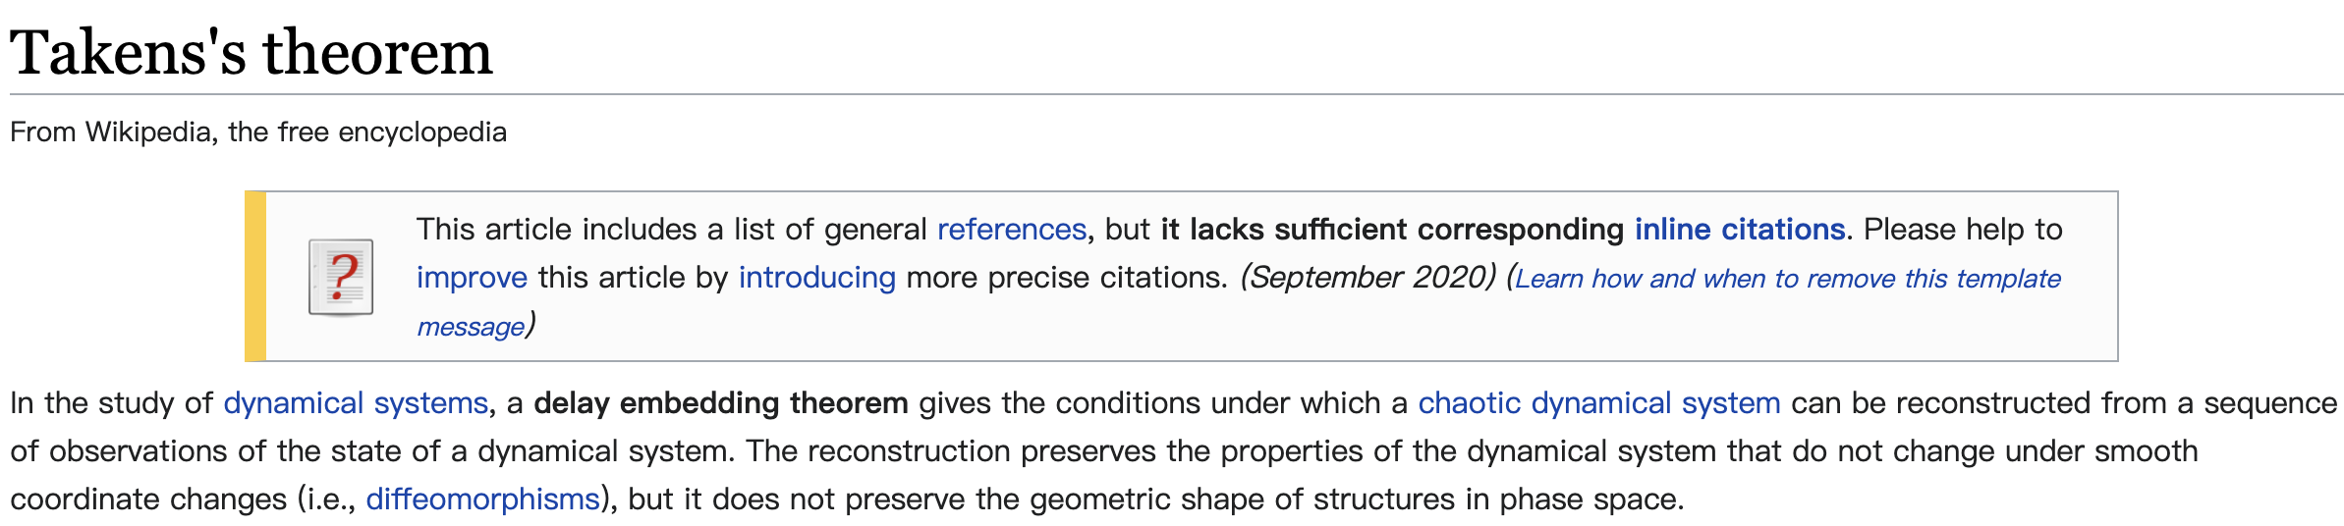
Problem Definition
Behavior (observations)
AI systems
Models
Predict Next Time Step
Abstractor reconstruction
Polynomial regression
Compressed sensing
Driving response
Reservoir Computing
Time series analysis…
https://en.wikipedia.org/wiki/Takens's_theorem

Slide 12
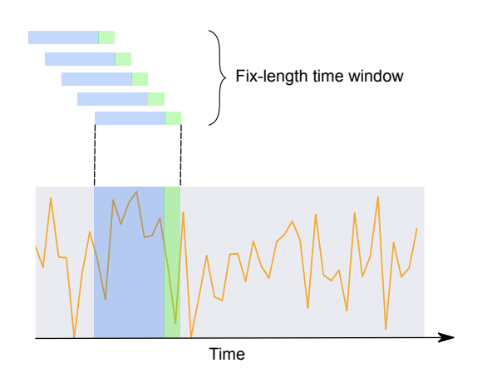
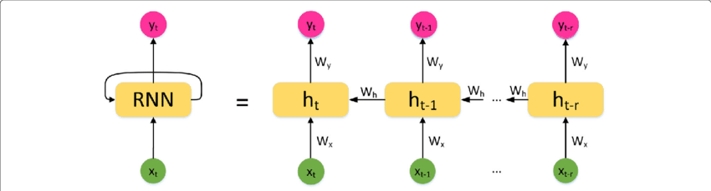
RNN based Dynamics Learning
t
更多“人工智能 & 复杂系统”的知识，请关注官网：campus.swarma.org

Slide 13
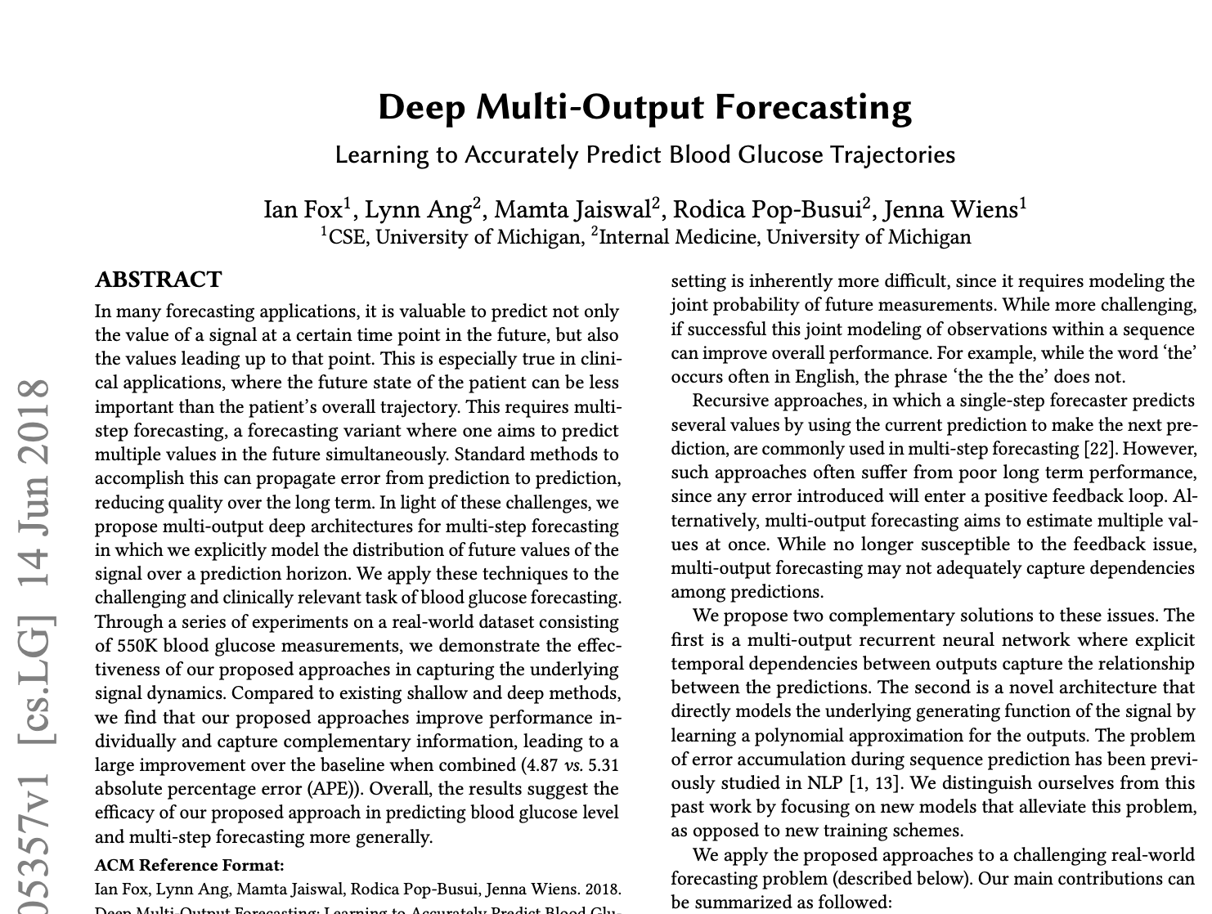
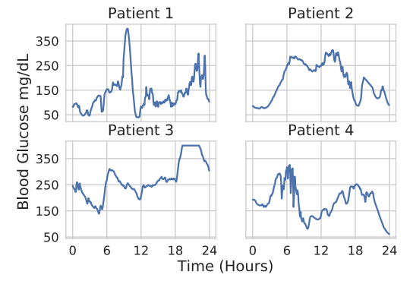
RNN based Dynamics Learning
Ian Fox, Lynn Ang, Mamta Jaiswal, Rodica Pop-Busui, and Jenna Wiens. Deep multi-output forecasting: Learning to accurately predict blood glucose trajectories. In Proceedings of the 24th ACM SIGKDD International Conference on Knowledge Discovery & Data Mining, pages 1387–1395. ACM, 2018.

Slide 14
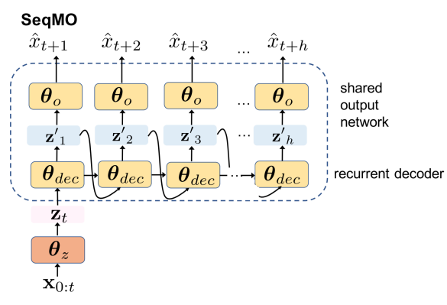
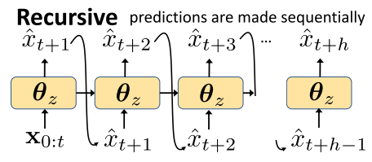
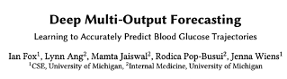
Recursive v.s. Multi-output
Forecasting with DeepMO involves transforming the input to a shared representation and then learning separate output networks for each time point in the prediction horizon h.
Ian Fox, Lynn Ang, Mamta Jaiswal, Rodica Pop-Busui, and Jenna Wiens. Deep multi-output forecasting: Learning to accurately predict blood glucose trajectories. In Proceedings of the 24th ACM SIGKDD International Conference on Knowledge Discovery & Data Mining, pages 1387–1395. ACM, 2018.

Slide 15
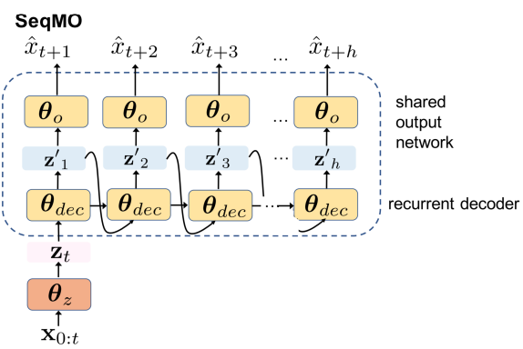
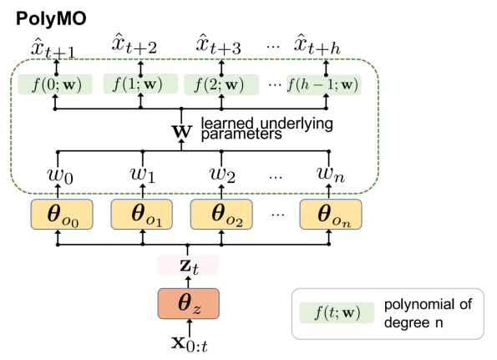
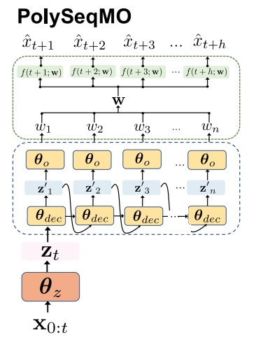
Neural Network v.s. Polynomial
Ian Fox, Lynn Ang, Mamta Jaiswal, Rodica Pop-Busui, and Jenna Wiens. Deep multi-output forecasting: Learning to accurately predict blood glucose trajectories. In Proceedings of the 24th ACM SIGKDD International Conference on Knowledge Discovery & Data Mining, pages 1387–1395. ACM, 2018.

Slide 16
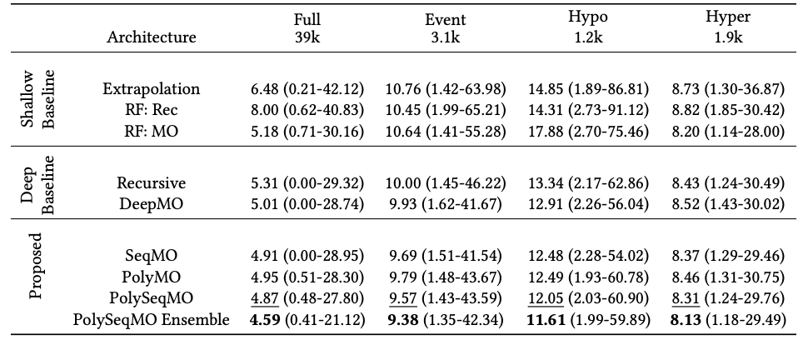
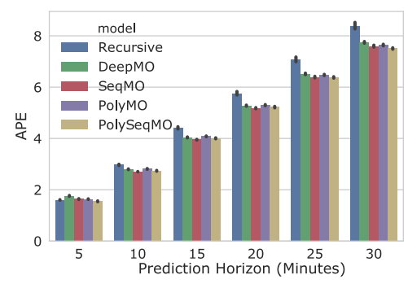
Results
Ian Fox, Lynn Ang, Mamta Jaiswal, Rodica Pop-Busui, and Jenna Wiens. Deep multi-output forecasting: Learning to accurately predict blood glucose trajectories. In Proceedings of the 24th ACM SIGKDD International Conference on Knowledge Discovery & Data Mining, pages 1387–1395. ACM, 2018.

Slide 17
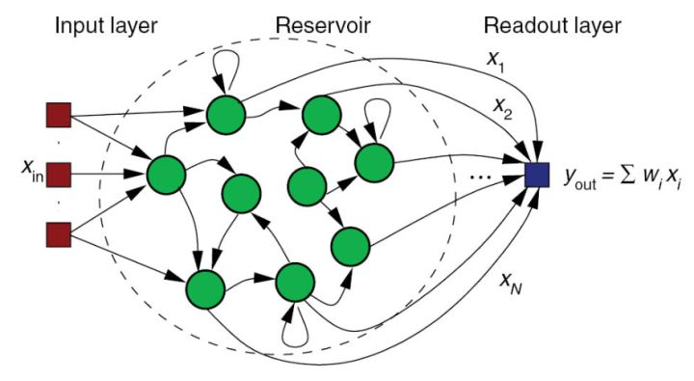
Reservoir Computing
https://en.wikipedia.org/wiki/Reservoir_computing

Slide 18
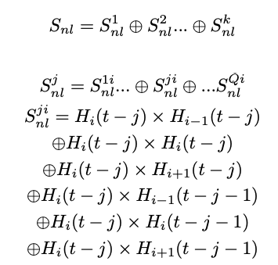
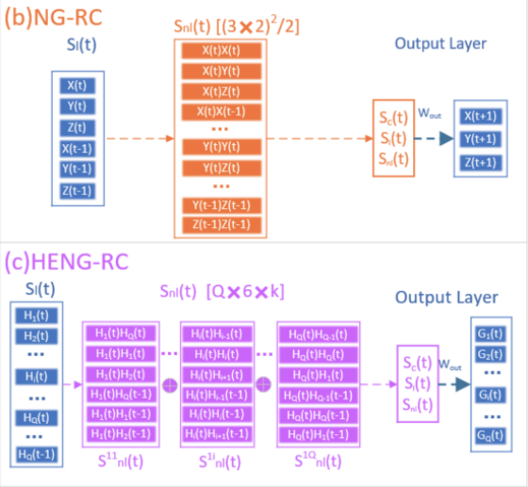
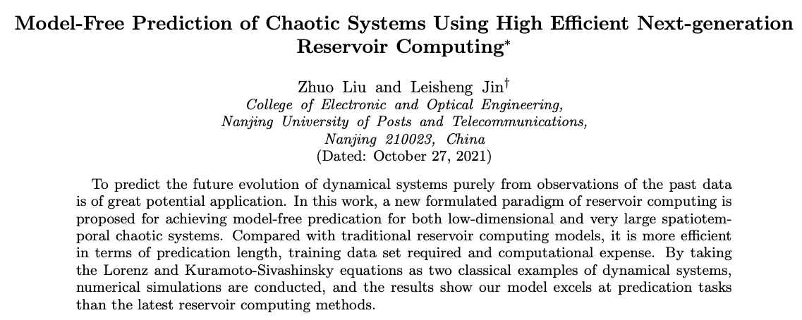
Predict Chaotic Dynamics
Phys. Rev. Lett. 120, 024102

Slide 19
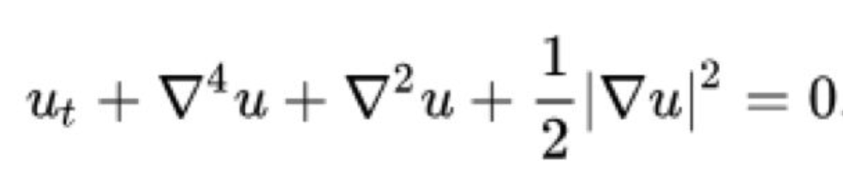

Kuramoto-Sivashinsky equation:
Predict Chaotic Dynamics
Phys. Rev. Lett. 120, 024102

Slide 20
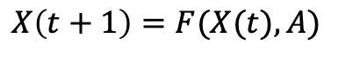
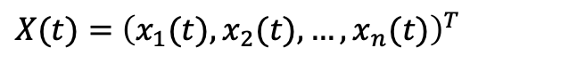
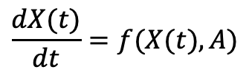
Dynamics on Graph
$$\frac{dX(t)}{dt}=f(X(t),A)$$
$X(t)=$ ${\left(x_{1}(t),x_{2}(t),…, x_{n}(t)\right)}^{T}$
$$X\left(t+1\right)=F(X(t),A)$$
更多“人工智能 & 复杂系统”的知识，请关注官网：campus.swarma.org

Slide 21
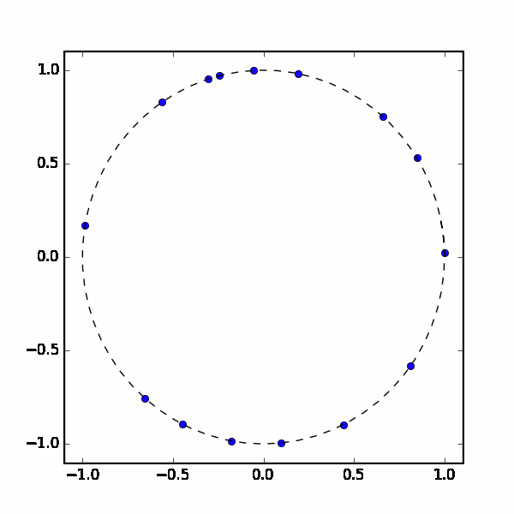
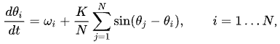
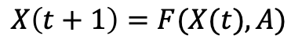
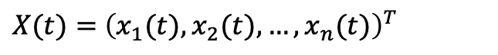
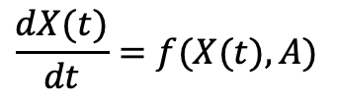
Dynamics on Graph
$$\frac{dX(t)}{dt}=f(X(t),A)$$
$X(t)=$ ${\left(x_{1}(t),x_{2}(t),…, x_{n}(t)\right)}^{T}$
$$X\left(t+1\right)=F(X(t),A)$$
更多“人工智能 & 复杂系统”的知识，请关注官网：campus.swarma.org

Slide 22
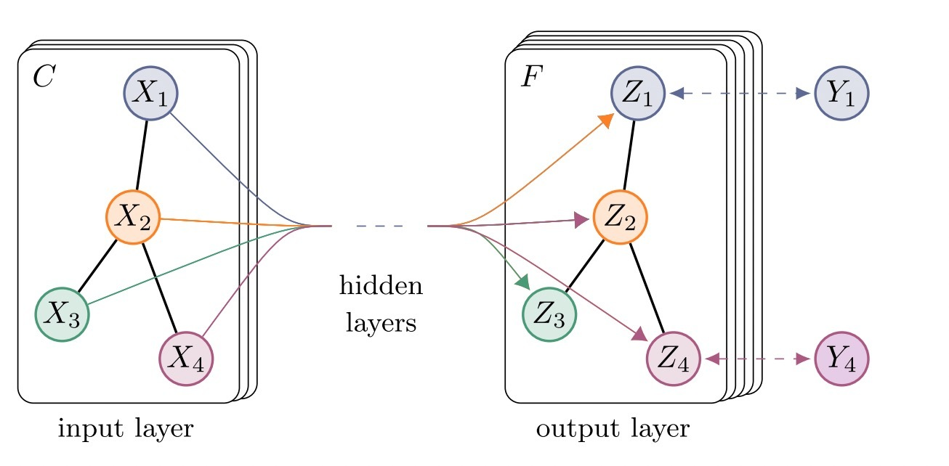
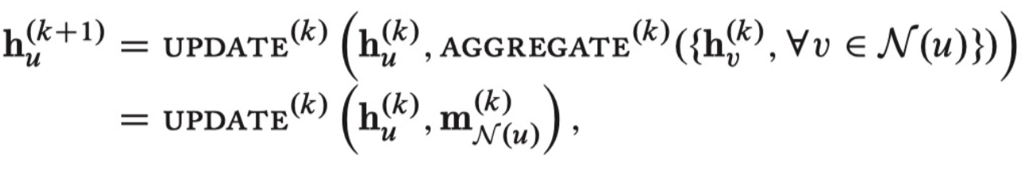
Learning on Graph
更多“人工智能 & 复杂系统”的知识，请关注官网：campus.swarma.org

Slide 23
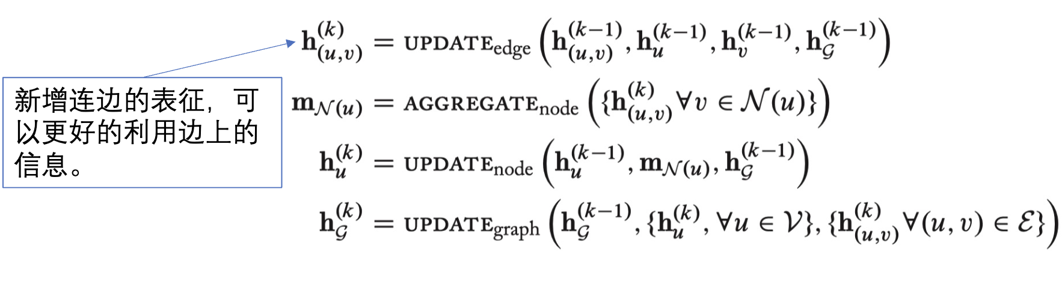
Extended Graph Neural Network
更多“人工智能 & 复杂系统”的知识，请关注官网：campus.swarma.org

Slide 24
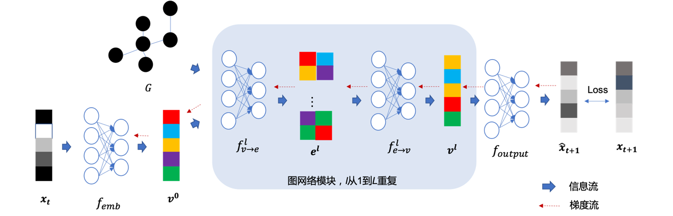
Dynamics Learning on Graph
更多“人工智能 & 复杂系统”的知识，请关注官网：campus.swarma.org

Slide 25
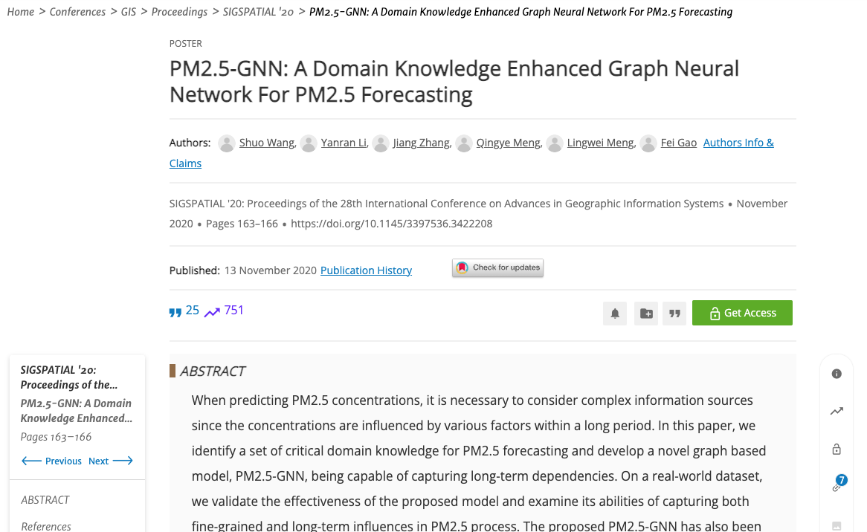
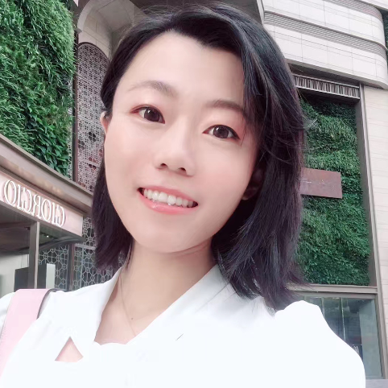
PM2.5 Forecasting
王硕
李嫣然
Shuo Wang, Yanran Li, Jiang Zhang, Qingye Meng, Lingwei Meng, and Fei Gao. 2020. PM2.5-GNN: A Domain Knowledge Enhanced Graph Neural Network For PM2.5 Forecasting. In Proceedings of the 28th International Conference on Advances in Geographic Information Systems (SIGSPATIAL '20). Association for Computing Machinery, New York, NY, USA, 163–166. https://doi.org/10.1145/3397536.3422208

Slide 26
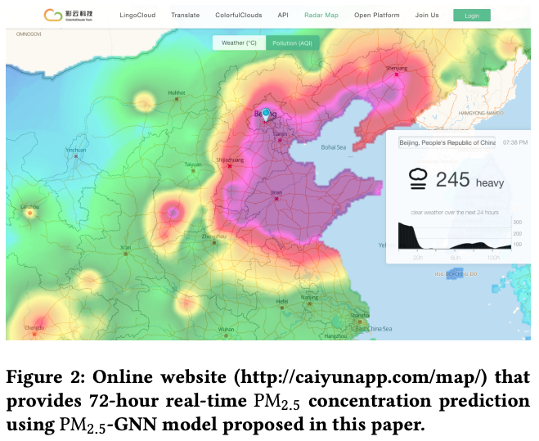
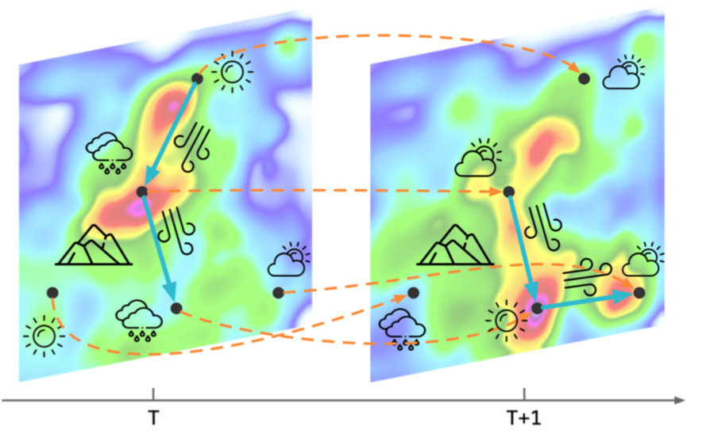
Tasks
Shuo Wang, Yanran Li, Jiang Zhang, Qingye Meng, Lingwei Meng, and Fei Gao. 2020. PM2.5-GNN: A Domain Knowledge Enhanced Graph Neural Network For PM2.5 Forecasting. In Proceedings of the 28th International Conference on Advances in Geographic Information Systems (SIGSPATIAL '20). Association for Computing Machinery, New York, NY, USA, 163–166. https://doi.org/10.1145/3397536.3422208

Slide 27
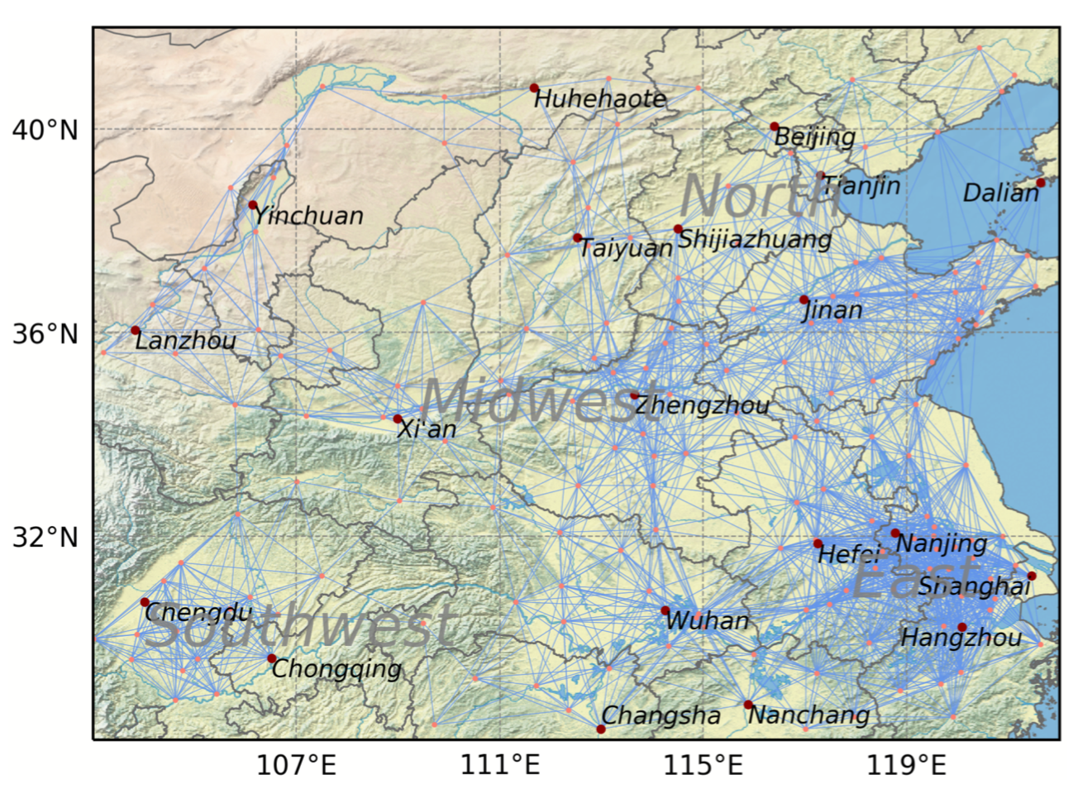
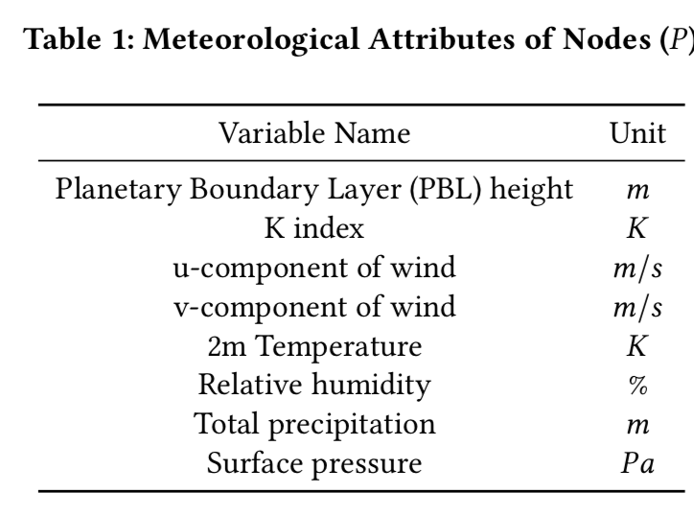
Input Attributes
Shuo Wang, Yanran Li, Jiang Zhang, Qingye Meng, Lingwei Meng, and Fei Gao. 2020. PM2.5-GNN: A Domain Knowledge Enhanced Graph Neural Network For PM2.5 Forecasting. In Proceedings of the 28th International Conference on Advances in Geographic Information Systems (SIGSPATIAL '20). Association for Computing Machinery, New York, NY, USA, 163–166. https://doi.org/10.1145/3397536.3422208

Slide 28
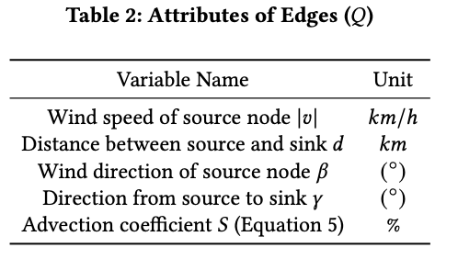
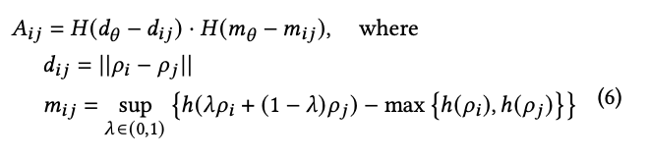
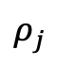



Network Constructing
$$ρ_{i}$$
$$d_{ij}$$
$$ρ_{j}$$
h
$$H\left(x\right)=\left\{\begin{matrix}1. if x>0 \\ 0. if x≤0\end{matrix}\right.$$
Shuo Wang, Yanran Li, Jiang Zhang, Qingye Meng, Lingwei Meng, and Fei Gao. 2020. PM2.5-GNN: A Domain Knowledge Enhanced Graph Neural Network For PM2.5 Forecasting. In Proceedings of the 28th International Conference on Advances in Geographic Information Systems (SIGSPATIAL '20). Association for Computing Machinery, New York, NY, USA, 163–166. https://doi.org/10.1145/3397536.3422208

Slide 29





Model
Shuo Wang, Yanran Li, Jiang Zhang, Qingye Meng, Lingwei Meng, and Fei Gao. 2020. PM2.5-GNN: A Domain Knowledge Enhanced Graph Neural Network For PM2.5 Forecasting. In Proceedings of the 28th International Conference on Advances in Geographic Information Systems (SIGSPATIAL '20). Association for Computing Machinery, New York, NY, USA, 163–166. https://doi.org/10.1145/3397536.3422208

Slide 30

Results – Time Series
Shuo Wang, Yanran Li, Jiang Zhang, Qingye Meng, Lingwei Meng, and Fei Gao. 2020. PM2.5-GNN: A Domain Knowledge Enhanced Graph Neural Network For PM2.5 Forecasting. In Proceedings of the 28th International Conference on Advances in Geographic Information Systems (SIGSPATIAL '20). Association for Computing Machinery, New York, NY, USA, 163–166. https://doi.org/10.1145/3397536.3422208

Slide 31




Results
Shuo Wang, Yanran Li, Jiang Zhang, Qingye Meng, Lingwei Meng, and Fei Gao. 2020. PM2.5-GNN: A Domain Knowledge Enhanced Graph Neural Network For PM2.5 Forecasting. In Proceedings of the 28th International Conference on Advances in Geographic Information Systems (SIGSPATIAL '20). Association for Computing Machinery, New York, NY, USA, 163–166. https://doi.org/10.1145/3397536.3422208

Slide 32

Ablation – Domain Knowledge
Shuo Wang, Yanran Li, Jiang Zhang, Qingye Meng, Lingwei Meng, and Fei Gao. 2020. PM2.5-GNN: A Domain Knowledge Enhanced Graph Neural Network For PM2.5 Forecasting. In Proceedings of the 28th International Conference on Advances in Geographic Information Systems (SIGSPATIAL '20). Association for Computing Machinery, New York, NY, USA, 163–166. https://doi.org/10.1145/3397536.3422208

Slide 33
Outline
Complex Systems and Modelling Methods
Dynamics Learning
Network Reconstruction
Multi-scale Modelling
Simulation, optimization, and control
更多“人工智能 & 复杂系统”的知识，请关注官网：campus.swarma.org

Slide 34

Network Reconstruction
Graph Neural Network
Inferred Network and Dynamics
更多“人工智能 & 复杂系统”的知识，请关注官网：campus.swarma.org

Slide 35





Various Dynamics
$$x_{i}\left(t+1\right)=\left(1−s\right)h\left(x_{i}\left(t\right)\right)+\frac{s}{D}\sum_{j≠i}{h\left(x_{j}\left(t\right)\right)}$$
$$\frac{dφ_{i}}{dt}=ω_{i}+k\sum_{j≠i}{A_{ij}sin⁡ (φ_{i}−φ_{j})}$$
$$h\left(x\right)=λx(1−x)$$
35
https://journals.aps.org/pre/abstract/10.1103/PhysRevE.106.034315

Slide 36
Gumbel Graph Network
张章
赵诣
刘晶
王硕
陶如意
张江
Accepted by journal of applied network science
https://arxiv.org/abs/1812.11482v3

Slide 37


AIDD
张妍
https://journals.aps.org/pre/abstract/10.1103/PhysRevE.106.034315

Slide 38


Key Idea
Gumbel softmax trick
Idea from Granger Causality
https://journals.aps.org/pre/abstract/10.1103/PhysRevE.106.034315

Slide 39




Problem
Action 1
$$p_{θ}^{1}$$
A Differential Stochastic Machine with parameter
$$p_{θ}^{i}$$
$$p_{θ}^{2}$$
Action 2
Probility
Action 3
Action 4
$$p_{θ}^{5}$$
Action 5
Non differentiable
Eric Jang et al.: CATEGORICAL REPARAMETERIZATION WITH GUMBEL-SOFTMAX, ICRL 2017

Slide 40



Gumbel softmax
$$f\left(z\right)=f\left(y\right)$$
$$y=softmax\left(\log{P_{θ}\left(Y\right)}+g\right)=\frac{exp⁡(\frac{\log{{pθ}^{i}}+g^{i}}{τ})}{\sum_{i}{exp⁡(\frac{\log{{pθ}^{i}}+g^{i}}{τ})}}$$
$Z$ is a categorical variable (1,2,…,N) with probability
$$P_{θ}\left(Y\right)=\left({pθ}^{1},{pθ}^{2},…,{pθ}^{n}\right)$$
$g=\left(g^{1},g^{2},…,g^{n}\right)$ are iid for given distribution
gumbel distribution (0,1)
Eric Jang et al.: CATEGORICAL REPARAMETERIZATION WITH GUMBEL-SOFTMAX, ICRL 2017

Slide 41



Gumbel Random Noise
$$\operatorname{Pr}\left(j=\arg{\max_{i}\left({\log{p_{θ}^{i}}+g}_{i}\right)}\right)=\frac{p_{θ}^{i}}{\sum_{j}{p_{θ}^{j}}}$$
Eric Jang et al.: CATEGORICAL REPARAMETERIZATION WITH GUMBEL-SOFTMAX, ICRL 2017

Slide 42

Gumbel softmax
$$y_{i}=\frac{exp⁡(\frac{\log\left(p_{θ}^{i}\right)+g^{i}}{τ})}{\sum_{j=1}^{k}{exp⁡(\frac{\log\left(p_{θ}^{j}\right)+g^{j}}{τ})}}$$
Eric Jang et al.: CATEGORICAL REPARAMETERIZATION WITH GUMBEL-SOFTMAX, ICRL 2017

Slide 43



Network Generator
$${\left(\frac{exp⁡(\frac{\log{{αij}^{}}+g_{ij}}{τ})}{\exp\left(\frac{\log{{αij}^{}}+g_{ij}}{τ}\right)+exp⁡\left(\frac{log(1−{{αij}^{}})+g_{ij}}{τ}\right)}\right)}_{N×N}$$
$$\left(\begin{matrix}α_{11} & ⋯ & α_{1N} \\ ⋮ & α_{ij} & ⋮ \\ α_{N1} & ⋯ & α_{NN}\end{matrix}\right)$$
$$\left(\begin{matrix}0 & ⋯ & 1 \\ ⋮ & a_{ij} & ⋮ \\ 0 & ⋯ & 1\end{matrix}\right)$$
https://journals.aps.org/pre/abstract/10.1103/PhysRevE.106.034315

Slide 44

Results – Centrality
Gu, W., Gao, F., Lou, X. et al. Discovering latent node Information by graph attention network. Scientific Reports 11, 6967 (2021).

Slide 45




ARNI(Algorithm for Revealing Network Interactions )
https://www.nature.com/articles/s41467-017-02288-4

Slide 46



NRI(Neural Relational Inference)
https://arxiv.org/abs/1802.04687

Slide 47

Comparisons
https://journals.aps.org/pre/abstract/10.1103/PhysRevE.106.034315

Slide 48


Missing Nodes
https://journals.aps.org/pre/abstract/10.1103/PhysRevE.106.034315

Slide 49

Gene Network Reconstruction
https://journals.aps.org/pre/abstract/10.1103/PhysRevE.106.034315

Slide 50

Learning hidden interactions
更多“人工智能 & 复杂系统”的知识，请关注官网：campus.swarma.org

Slide 51
Boid Model
Boid model
Each boid follows 3 rules
Cohesion
Alignment
Separation
更多“人工智能 & 复杂系统”的知识，请关注官网：campus.swarma.org

Slide 52

Self-attention
https://www.nature.com/articles/s41598-021-91878-w

Slide 53


Self-attention visualization
更多“人工智能 & 复杂系统”的知识，请关注官网：campus.swarma.org
Notes:
Result of AgentNet for cellular automata. (A) Attention weight transition of a single target cell throughout the training. In the initial stage, the model has no information about interaction range and assigns nearly similar values to all of the cells in the system. Attention gets narrowed down to a smaller region as training advances, and finally concentrates into eight surrounding cells, which is the theoretical interaction range. (B), (C) AgentNet predictions with respect to given alive and dead microstates, respectively. The total number of alive cells in the neighborhood is denoted by s, which is the sole parameter of the CA decision rule.

Slide 54
Outline
Complex Systems and Modelling Methods
Dynamics Learning
Network Reconstruction
Multi-scale Modelling
Simulation, optimization, and control
更多“人工智能 & 复杂系统”的知识，请关注官网：campus.swarma.org

Slide 55




Multi-scale Modelling
Coarse Graining
Coarse Graining
Automated Modelling
Automated Modelling
Automated Modelling
$$\frac{dX_{S}}{dt}=f_{S}(X_{S})$$
$$\frac{dX_{M}}{dt}=f_{M}(X_{M})$$
$$\frac{dX_{L}}{dt}=f_{L}(X_{L})$$
Gu, W., Gao, F., Lou, X. et al. Discovering latent node Information by graph attention network. Scientific Reports 11, 6967 (2021).

Slide 56


Station - City
https://arxiv.org/abs/2101.04264v1

Slide 57



Skeleton-based action recognition
https://arxiv.org/abs/2206.13028

Slide 58

Graph U-Net
https://arxiv.org/abs/1905.05178

Slide 59

U-Net
https://arxiv.org/abs/1505.04597

Slide 60

How to Down Sampling a Graph?
https://arxiv.org/abs/1905.05178

Slide 61


How to Down Sampling a Graph?
https://arxiv.org/abs/1905.05178

Slide 62
Whole Picture
https://arxiv.org/abs/1905.05178

Slide 63
Outline
Complex Systems and Modelling Methods
Dynamics Learning
Network Reconstruction
Multi-scale Modelling
Simulation, optimization, and control
更多“人工智能 & 复杂系统”的知识，请关注官网：campus.swarma.org

Slide 64
Automated Modelling of Complex Systems
Complex System
Behavior (observations)
AI systems
Models
Prediction, Simulation, Optimization, Controls
更多“人工智能 & 复杂系统”的知识，请关注官网：campus.swarma.org

Slide 65


Surrogate Model - DeepRSM
[1] Xing J, Zheng S, Ding D, et al. Deep learning for prediction of the air quality response to emission changes[J]. Environmental Science & Technology, 2020.
[2] Cohen A J, Brauer M, Burnett R, et al. Estimates and 25-year trends of the global burden of disease attributable to ambient air pollution: an analysis of data from the Global Burden of Diseases Study 2015[J]. The Lancet, 2017, 389(10082): 1907-1918.

Slide 66


Learning to Simulate Complex Physics with Graph Networks
https://arxiv.org/abs/2002.09405

Slide 67


Automated Modelling of Complex Systems
Control law
Learned
Control law
Real
https://journals.aps.org/pre/abstract/10.1103/PhysRevE.106.034315

Slide 68

Automated Modelling of Complex Systems
https://journals.aps.org/pre/abstract/10.1103/PhysRevE.106.034315

Slide 69
Ladder of Causality
Judea Pearl: The Book of Why

Slide 70
Summary
Learning Complex Dynamics
Learning Dynamics on Networks
Learning Interaction Networks (Unsupervised)
Learning Multi-scale Dynamics
Applications of Surrogate Model
更多“人工智能 & 复杂系统”的知识，请关注官网：campus.swarma.org

